Slide 1

Final Project: Why Go Solar
UC Berkeley Data Analytics Bootcamp Final Project

Slide 2
Team Members
Jacob Zebker,
Kellen Schmitz
Chung In Ngan,
Angela Kumar
Team SunnyDay: Jacob Zebker, Kellen Schmitz, Chung In “Angel” Ngan, Angela Kumar

Slide 3
Selected Topic for Analysis: Residential Solar
Our team wanted to promote the adoption of residential solar power.
Many reasons to use solar:
Reduce dependence on fossil fuels
Save money
Power backup during blackouts
We chose to focus on the financial component (since this is usually the deciding factor)
Specifically, we looked at which variables had the most impact on installation costs
Team SunnyDay: Jacob Zebker, Kellen Schmitz, Chung In “Angel” Ngan, Angela Kumar

Slide 4

Purpose and Overview
The topic was selected due many factors:
Climate change and global warming
Power outages, wildfires, and other natural disasters
Increased greenhouse gas emissions
Increased interest in renewable energy specifically rooftop solar and energy storage.
Cost savings on electric

Slide 5
Description of the Source of Data
The source data was primarily from Governmental Sources.
Electricity Rates by State -
https://www.eia.gov/electricity/state/
https://www.eia.gov/electricity/data/state/avgprice_annual.xlsx
Solar PV Supply Data -
https://www.nrel.gov/gis/solar-supply-curves.html
https://developer.nrel.gov/docs/solar/nsrdb/
US Zipcode Database - https://www.unitedstateszipcodes.org/zip-code-database/
Team SunnyDay: Jacob Zebker, Kellen Schmitz, Chung In “Angel” Ngan, Angela Kumar
Notes:
Discuss the challenges finding data:
Massive data sets that needed cleaning and interpreting (census data)
Merging data from disparate sources

Slide 6
Data Visualization
–
Tableau
Energy Cost
Power Outages
Greenhouse Gases
Power Options: Sunlight
By Chung In, Ngan (Angel)
Team SunnyDay: Jacob Zebker, Kellen Schmitz, Chung In “Angel” Ngan, Angela Kumar

Slide 7
Tableau Visualization
Click Here
Team SunnyDay: Jacob Zebker, Kellen Schmitz, Chung In “Angel” Ngan, Angela Kumar
Notes:
Discuss the interactive part of the dashboard
Note any interesting observations in the charts

Slide 8

Questions We Hope to Answer with the Data
When the user enters variables such as zip code and current electric bill does the global horizontal irradiance predict accurately for the zip code entered?
Based on the zip code,average electric rates the state incurs per kwh along with average cost of the the solar system installation, how many years does it take to breakeven on the cost?
Team SunnyDay: Jacob Zebker, Kellen Schmitz, Chung In “Angel” Ngan, Angela Kumar

Slide 9
Description of the Data Exploration Phase
Difficult to find current data
Lots of sources for historical data
Data can be clean or messy depending on source
Hard to interconnect or select the features as there were a number of variables.

Slide 10
Description of the Analysis Phase
Solar System Sizing and Cost
State Electric Cost Analysis
Breakeven Cost and Number of years that the installation will pay off
By Kellen Schmitz

Slide 11
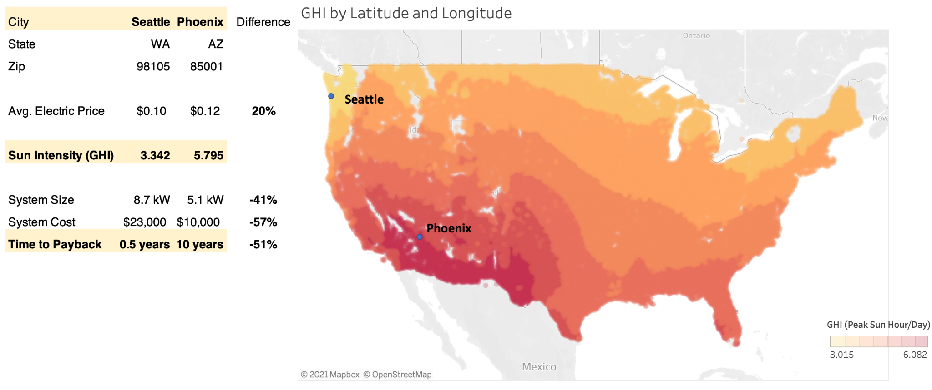
Solar System Installation Cost Analysis

Slide 12
Machine Learning
Prediction
Tools used: Pandas, SQL, Sklearn, HTML/Flask
Key factors
- potential solar energy
- electric price
- panel efficiency/price
By Jacob Zebker
Goal: Predict GHI based on location to calculate payback period when going solar

Slide 13
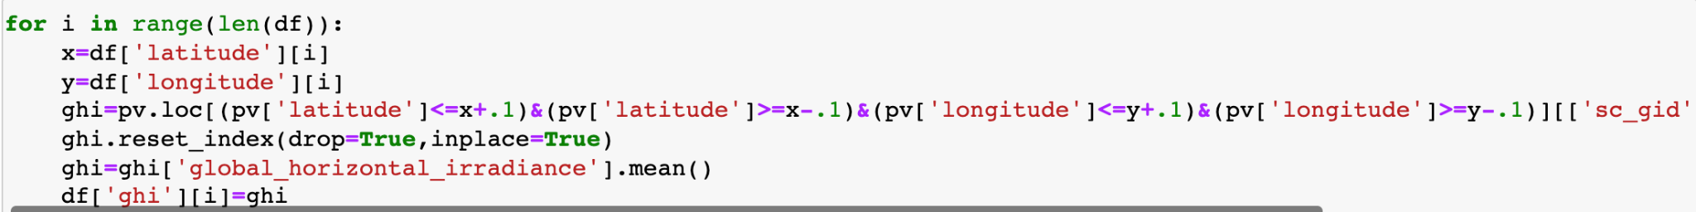
Why ML?
Big dataset
Conventional calculations are slow and unwieldy
Easily display accuracy value
Notes:
ML fills in the gaps in GHI observations

Slide 14
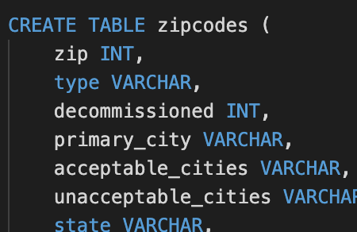
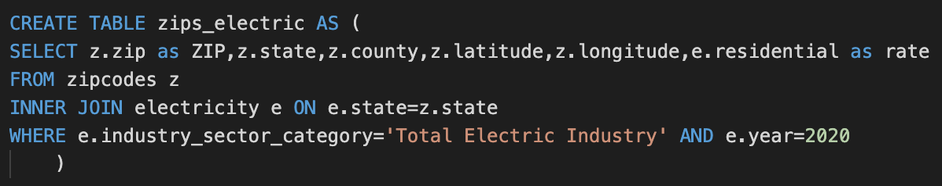
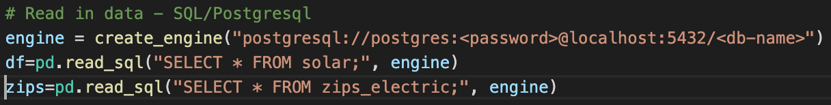
SQL Database
for ML Model
1) Read in data
2) SQL JOIN
3) Connect to model with SQLAlchemy

Slide 15
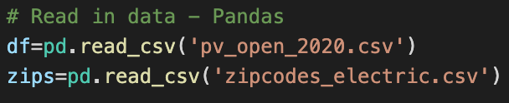

We can also do this with Pandas and CSVs
1) Pandas merge
2) Export CSV
3) Read in data

Slide 16
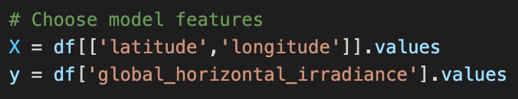
The Model
Random ⅓ of data used as test
Why RandomForestRegressor?
Large dataset
No need to extrapolate beyond US
Continuous data
R2 score?
Few outliers
Low variance from point to point
Zip Codes are not numeric data
Notes:
Why choose features? GHI is measured at different lat/lng so use the coords as features. Fill in gaps

Slide 17
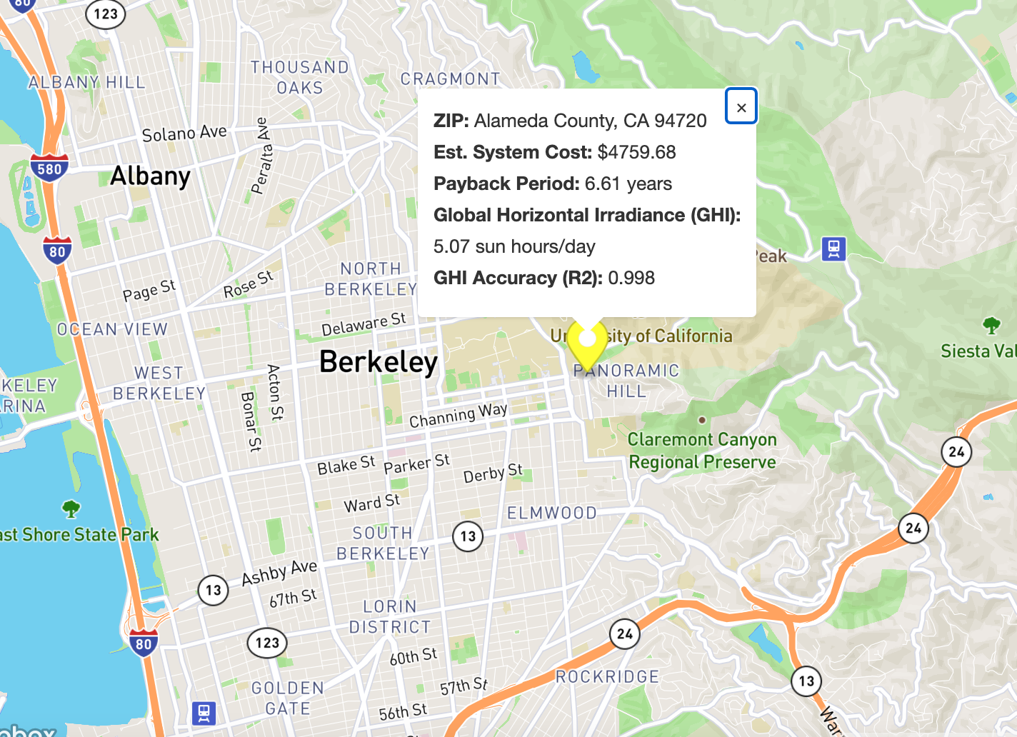
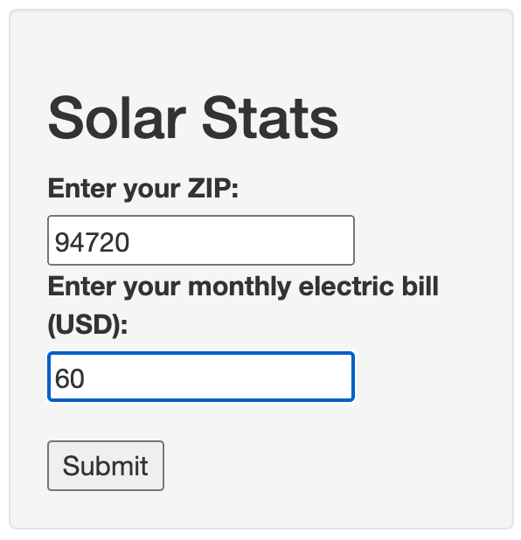
Flask App Demo
Sample Output
User Inputs
Notes:
Assumptions/Simplifications - For payback we have assumed solar makes electric bill go to zero
Uses latitude and longitude from center of zip
GHI values used are averages from annual measurement so we are not taking into account sun fluctuation throughout the year
Assuming monthly elec bill is 1/12 of yearly
Using constant elec rate for 2020 per state

Slide 18
Machine Learning Demo

Slide 19
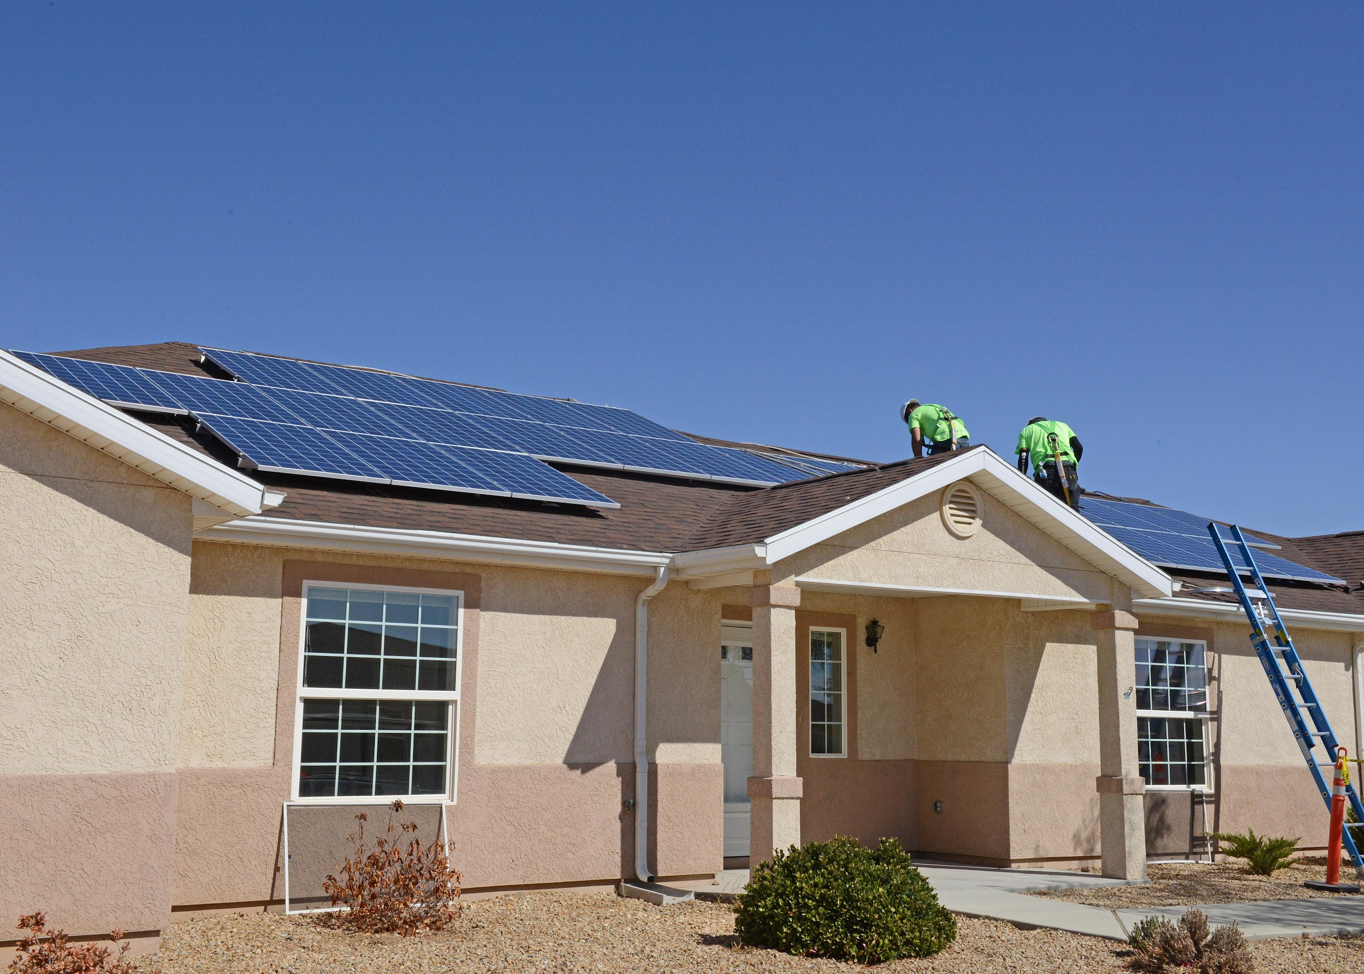
Summary of Our Finding as Team Sunny Day
Climate change is real and we need to do something about the planet.
Renewable energy such as solar, specifically photovoltaic panel installation can be used on the rooftop saves on electric savings.

Slide 20

Questions
Questions?

Slide 21

Thank You
Thank you for your time

Slide 22
Conclusion on what we learned in class
Data can be made to forge a relationship with unrelated data to gain more insight, perspectives, or have better outcomes with Python, Pandas, PostgreSQL.
We learned new technologies to present our findings with Tableau, Plotly, and Javascript
It is how we are able to use data to communicate our ideas, persuade another to make key decisions.
Data is used to review trends and patterns and can train the computer to make predictions or test assumptions using supervised and unsupervised machine learning.

